Slide 1




FORECASTING MEDICAL INSURANCE COSTS
~Your Health, Our Mission.

Slide 2

OUR TEAM
GAYATHRI
322103383011
BHUVANA SANDHYA
322103383013
LOKHYA SRI
322103383023
EVELINA
322103383037
GOKUL ANNAM
322103383053

Slide 3


ABSTRACT
Aims to provide insurers with data-driven insights for pricing policies accurately, benefiting both the insurers and the policyholders.
Utilizes various data sources, including patient medical histories, insurance claim details, and demographic profiles, to ensure comprehensive analysis.
Results in improved accuracy in predicting medical expenses, enabling better premium suggestions.

Slide 4

PROJECT INTRODUCTION
Accurate medical insurance premiums and efficient healthcare resource management are crucial for the health and well-being of individuals and the sustainability of healthcare systems. This project aims to predict medical insurance costs using data analysis, machine learning, and advanced data visualization techniques.

Slide 5
MODULES
Block Diagram
Understanding the problem
Gathering Data
Exploring and Cleaning Data
Developing Predictive Models
Validating the Models
Implementing the solution
8.Conclusion

Slide 6
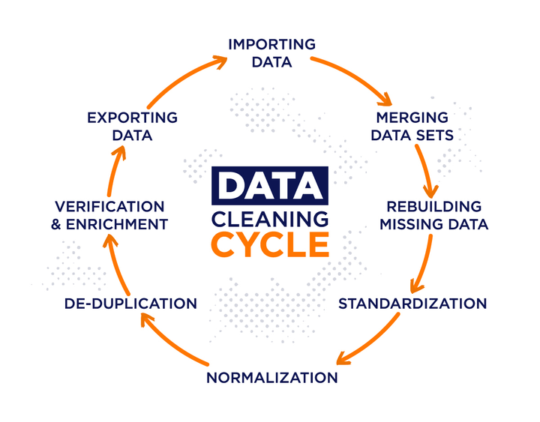
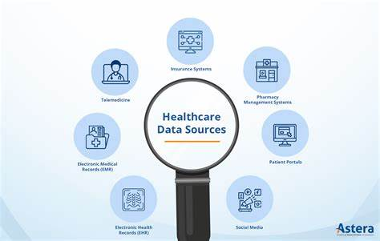
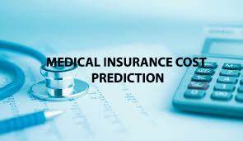
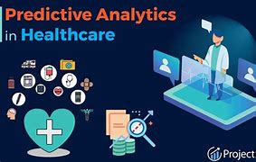
Block Diagram

Slide 7
UNDERSTANDING THE PROBLEM
Rising Healthcare Costs
Healthcare costs have been steadily increasing in recent years, putting a strain on individuals and healthcare systems.
Unpredictable Medical Expenses
Medical expenses can be unpredictable and vary greatly depending on factors such as age, health status, and lifestyle.
Need for Accurate Premiums
Insurance companies need to set accurate premiums that reflect the expected costs of providing coverage.
Efficient Resource Allocation
Healthcare providers need to allocate resources efficiently to meet the needs of the population.

Slide 8
GATHERING DATA
Collected 450Mb of data.
3.Health History
1. Medical Claims Data
Patient health history, including pre-existing conditions and past treatments, can provide insights into future healthcare needs.
Historical medical claims data is a valuable source of information about past medical expenses.
4.Lifestyle Factors
2.Patient Demographics
Lifestyle factors such as diet, exercise, and smoking habits can impact health outcomes and medical expenses.
Demographics such as age, gender, location, and socioeconomic status can influence medical costs.

Slide 9




DATA SOURCES
National Health Authority (NHA)
Insurance Regulatory and Development Authority of India (IRDAI)
World Health Organization (WHO)
Census of India
National Sample Survey Office (NSSO)
Ministry of Health and Family Welfare (MoHFW)
National Centre for Disease Control (NCDC)
The Cancer Imaging Archive (TCIA)
Kaggle Medica

Slide 10
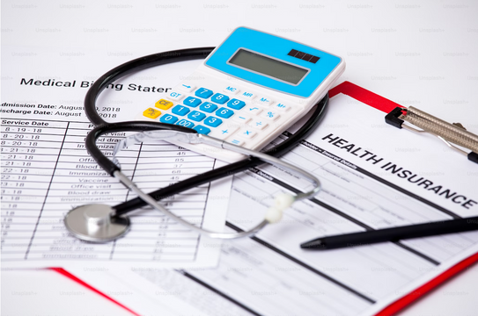





DATA SOURCES
MEDICAL BILLS
HEALTH INSURANCE DATA
CLAIMED DATA
WHO

Slide 11
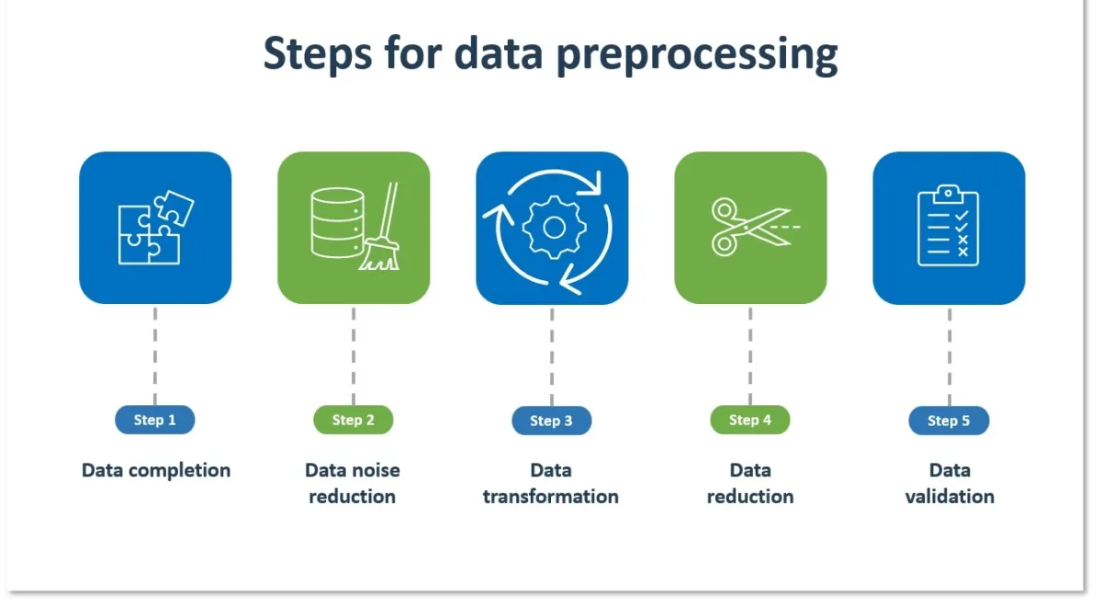

Slide 12
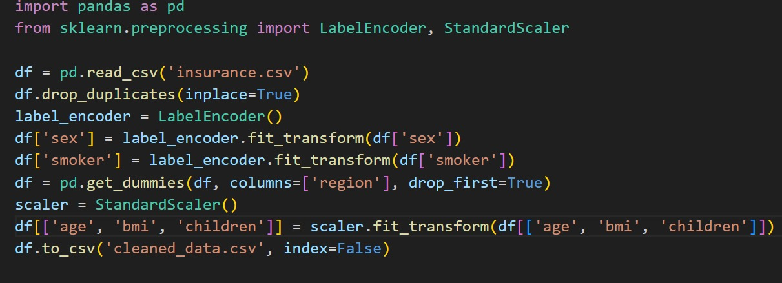
Data Preprocessing
Data Cleaning
Cleaning the data involves correcting errors, removing duplicates, and handling missing values.
Eg:Fixing typos in demographic information
Feature Engineering
Creating new features from existing data can enhance the predictive power of the models.
Ex: Age groups, risk factors, medical history summaries.

Slide 13


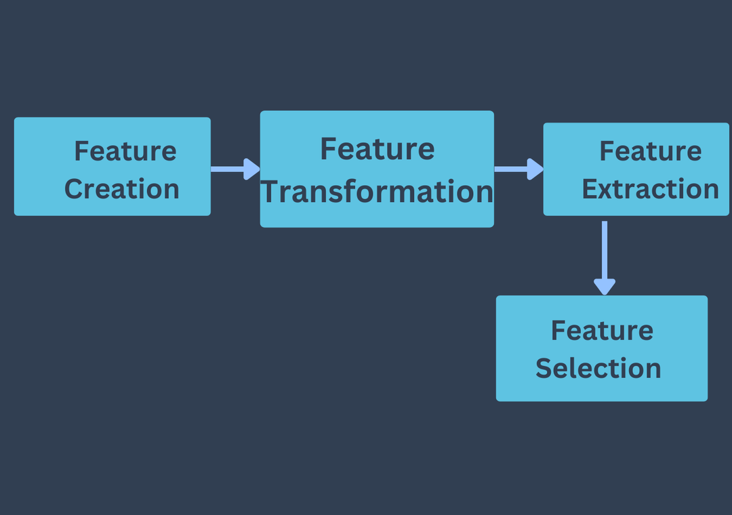
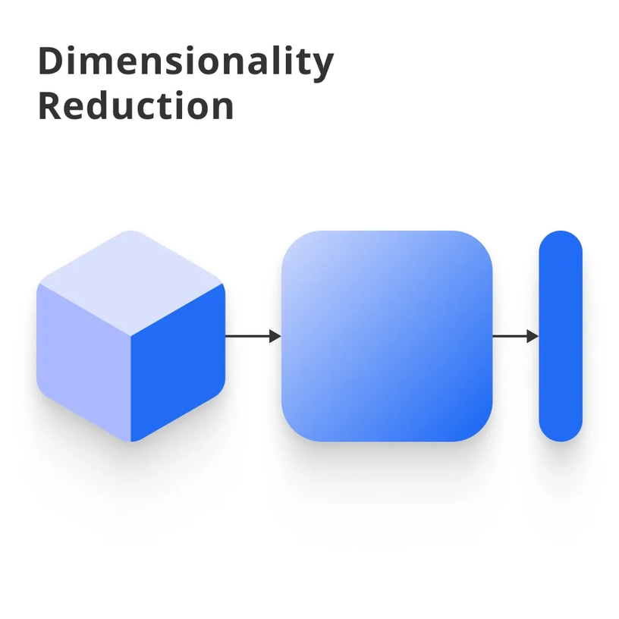

FEATURE ENGINEERING

Slide 14


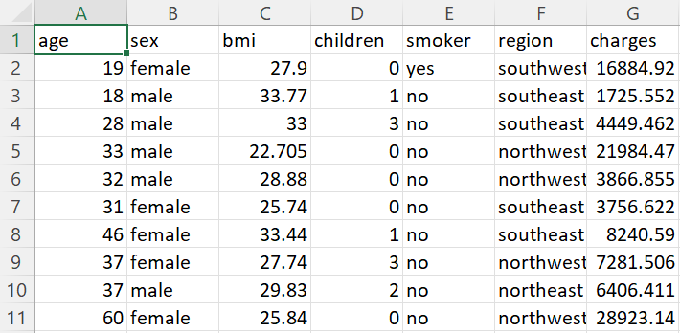

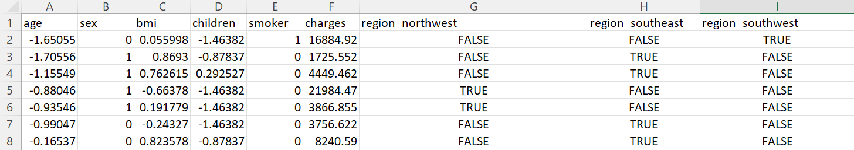

APPLICATIONS USED FOR FEATURE EXTRACTION AND SELECTION
SCIKIT IS A PYTHON PACKAGE USED FOR PROCESSING IMAGES
PYTHON

Slide 15

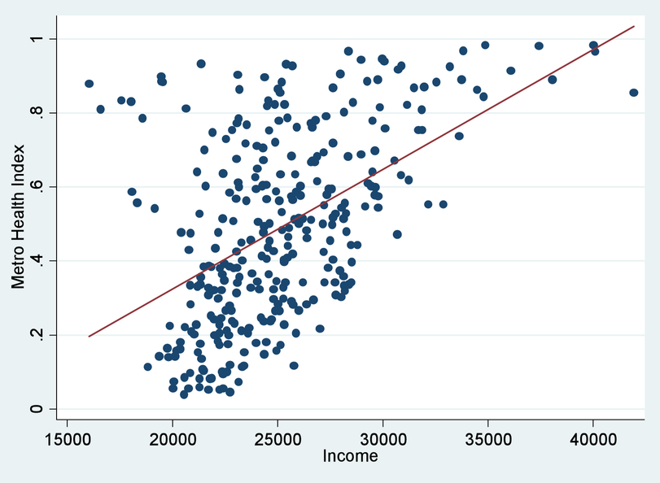

EXPLORATORY DATA ANALYSIS
STATISTICAL DATA
LINEAR REGRESSIONS
PYTHON

Slide 16
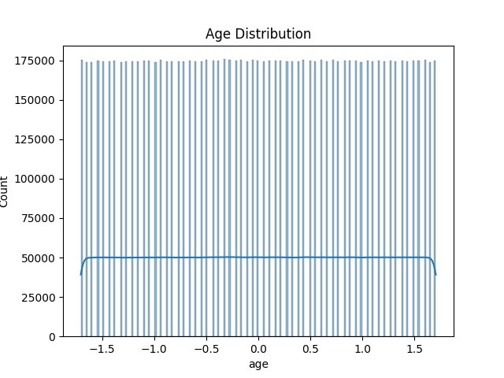
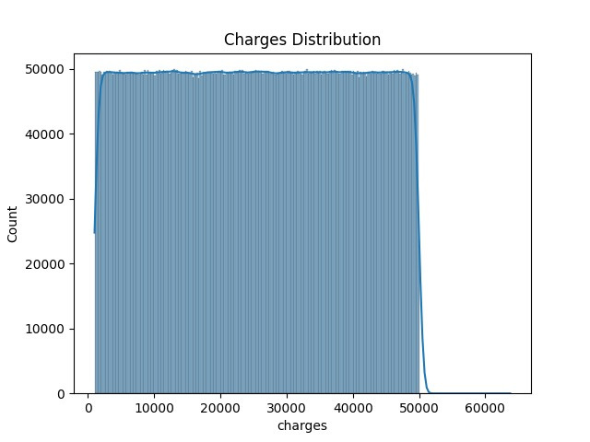
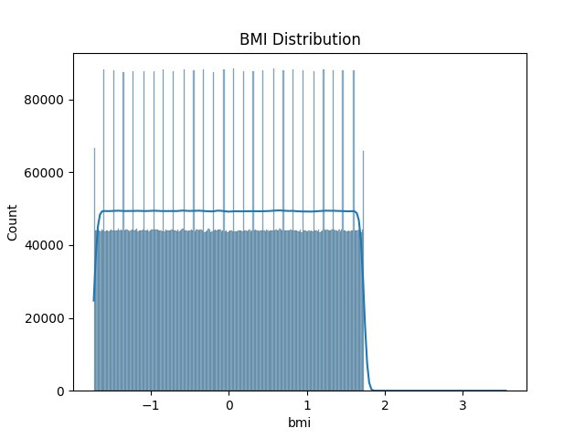


Slide 17
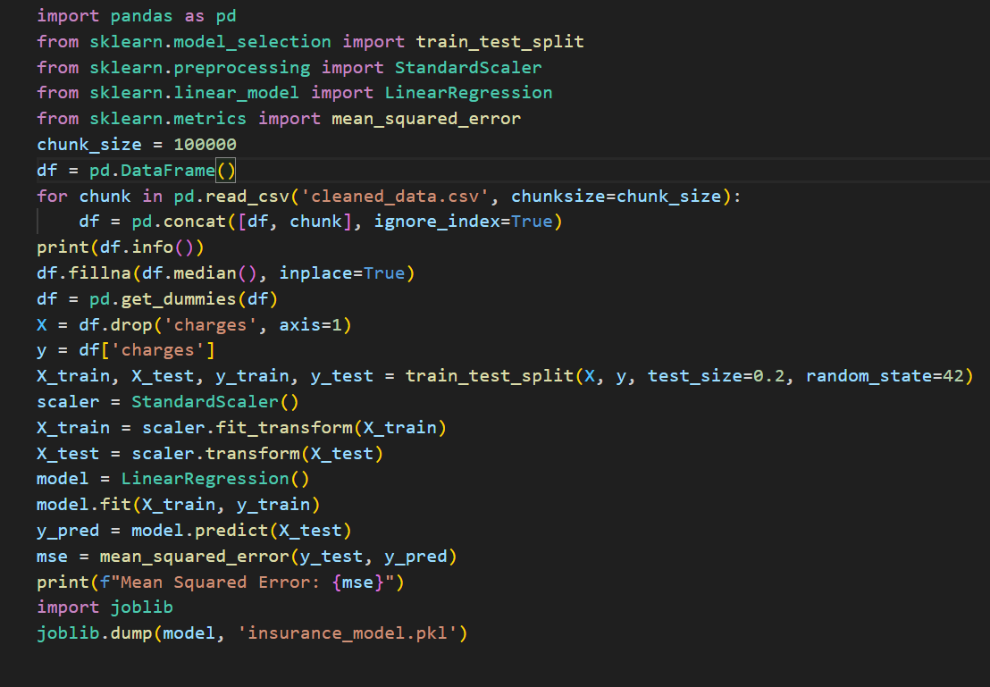


Developing Predictive Models
Regression models are employed to estimate healthcare costs based on factors such as age and medical history.

Slide 18



IMPLEMENTING THE SOLUTION
Model Deployment
The validated model is deployed into a production environment, where it can be used to make predictions.
Integration with Existing Systems
The model is integrated with existing insurance and healthcare systems to streamline the process of setting premiums.
Monitoring and Maintenance
The model is continuously monitored to ensure that it is performing as expected and is updated as needed.

Slide 19
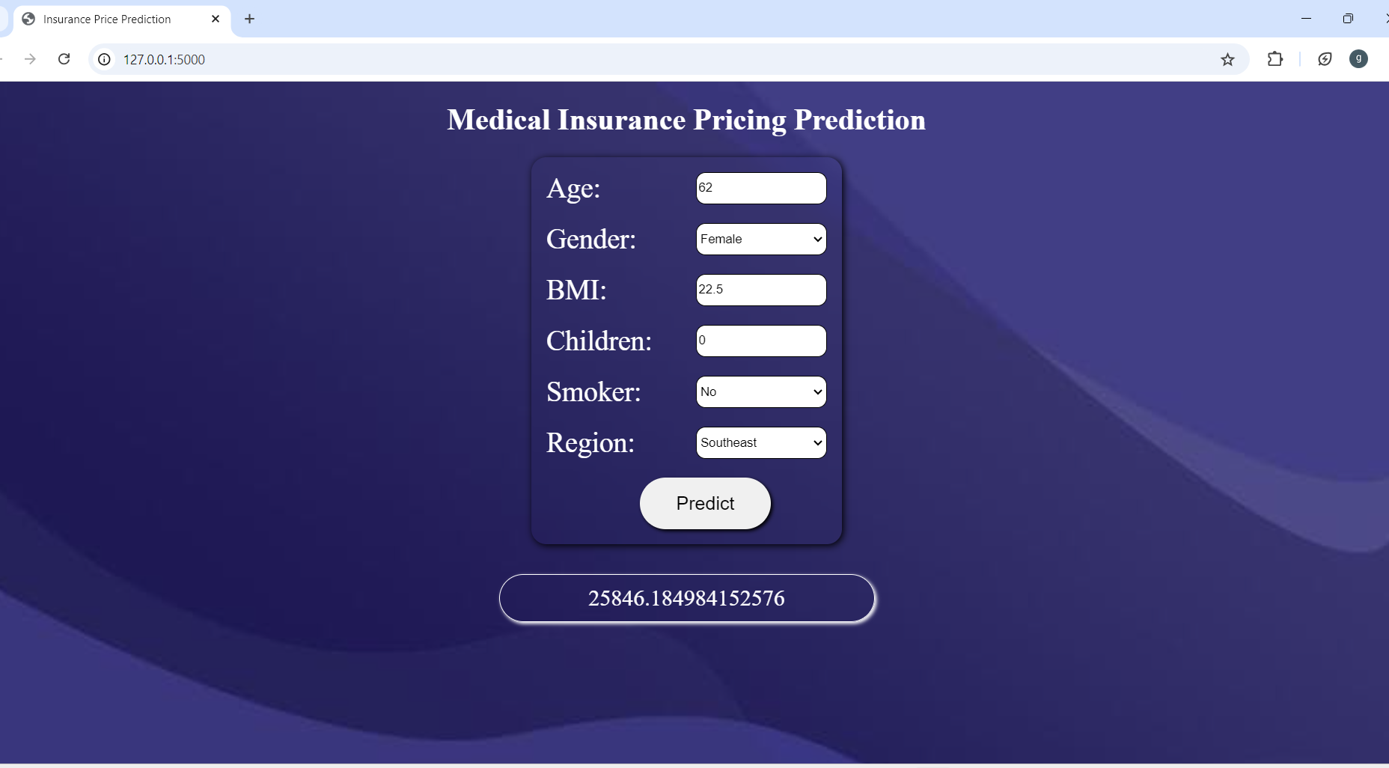

Slide 20



CONCLUSION
In summary, our project utilizes historical medical data and policyholder information as input to predict future medical expenses. By applying various data processing capabilities, we analyz this data to develop models that estimate potential costs and determine appropriate insurance premiums. The output of our project is a set of predictive insights and recommendations for setting premiums that reflect the anticipated risks and expenses for policyholders.

Slide 21
~THANK YOU~

